Slide 1
Sales Data Integration and Analysis

Slide 2
PROJECT Overview
The project aims to optimize the sales strategies of a mid-sized retail company by integrating and analyzing historical sales data scattered across multiple sources. The company’s in-store transactions are stored in a SQL database, online sales data resides in a NoSQL database, and promotional information is kept in Excel spreadsheets. These disparate data sources present challenges in terms of integration, consistency, and accessibility. The goal is to consolidate and clean the data from these various systems to gain actionable insights that can inform sales forecasts, inventory management, and promotional strategies. By leveraging advanced data analysis techniques and tools, the project will provide a comprehensive understanding of the company’s sales performance and suggest strategies to improve overall business efficiency and growth.

Slide 3
DATA SOURCES Overview
1. SQL Database for In-store Transactions: Stores structured data on in-store sales, such as product details, prices, and transaction dates, allowing for efficient analysis using SQL queries.
2. NoSQL Database for Online Sales: Holds unstructured data on online sales, including customer behavior and order history, providing flexibility for large-scale, dynamic data storage.
3. Excel Spreadsheets for Promotional Data: Tracks marketing campaigns, discounts, and promotions, offering a simple way to manage and evaluate the effectiveness of sales initiatives.

Slide 4
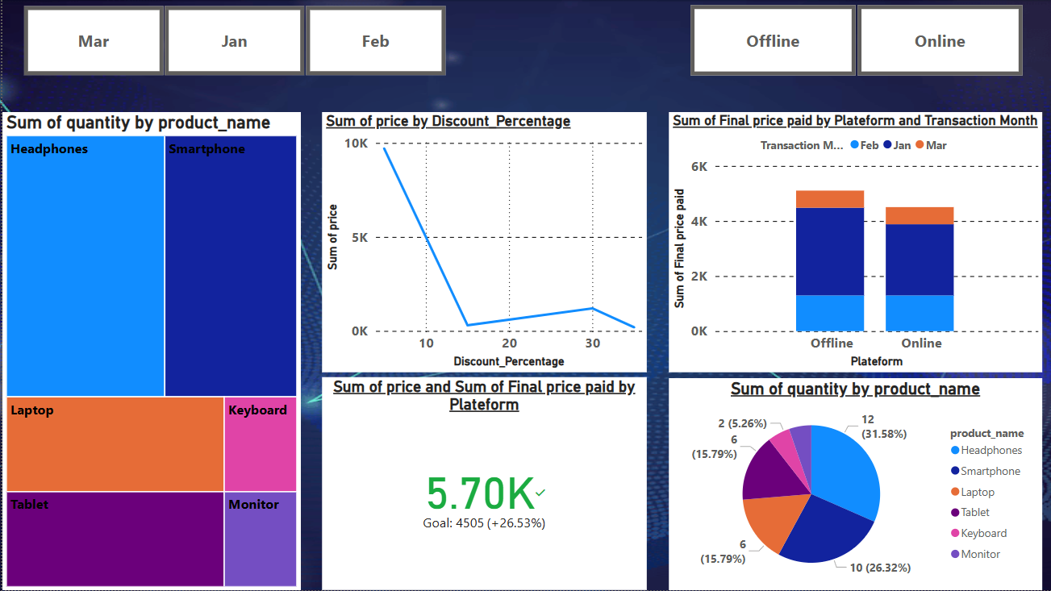
Sales Insights and Analytics

Slide 5
Challenges in Data Integration
Difficult to Connect MongoDB to Power BI: One major challenge encountered was the difficulty in directly connecting MongoDB to Power BI, as there is no native integration between the two.
2. Complexity of SQL Database Structure: The SQL database posed additional challenges due to the presence of multiple tables. This made it difficult to retrieve and consolidate the data efficiently, particularly since the promotional data was missing or incomplete. This lack of data consistency created issues when trying to analyze sales performance and promotional effectiveness.
3. Missing Promotional Data: Another challenge was the absence of crucial information in the promotional data, such as the promotion's start and end dates or its expiration. Without this data, it became challenging to assess the effectiveness of campaigns over time and track the performance of specific promotions.

Slide 6
Solutions to Overcome Data Integration Challenges
1. Connecting MongoDB to Power BI via ODBC Data Source: To overcome the challenge of connecting MongoDB to Power BI, I used the ODBC Data Source (64-bit) method. This allowed me to establish a connection between Power BI and MongoDB, enabling me to import and analyze data from the NoSQL database seamlessly.
2. Using Transaction Date to Identify Promo Codes in SQL: To handle the complexity of the SQL database, I leveraged the transaction date to identify which promo codes were used in specific transactions. This allowed me to match sales data with promotional activities, despite missing or incomplete promotional data in the database.

